Slide 1

Nottinghamshire Mine Water
9-Mar-12
Notes:
Presentation Title Screen

Slide 2
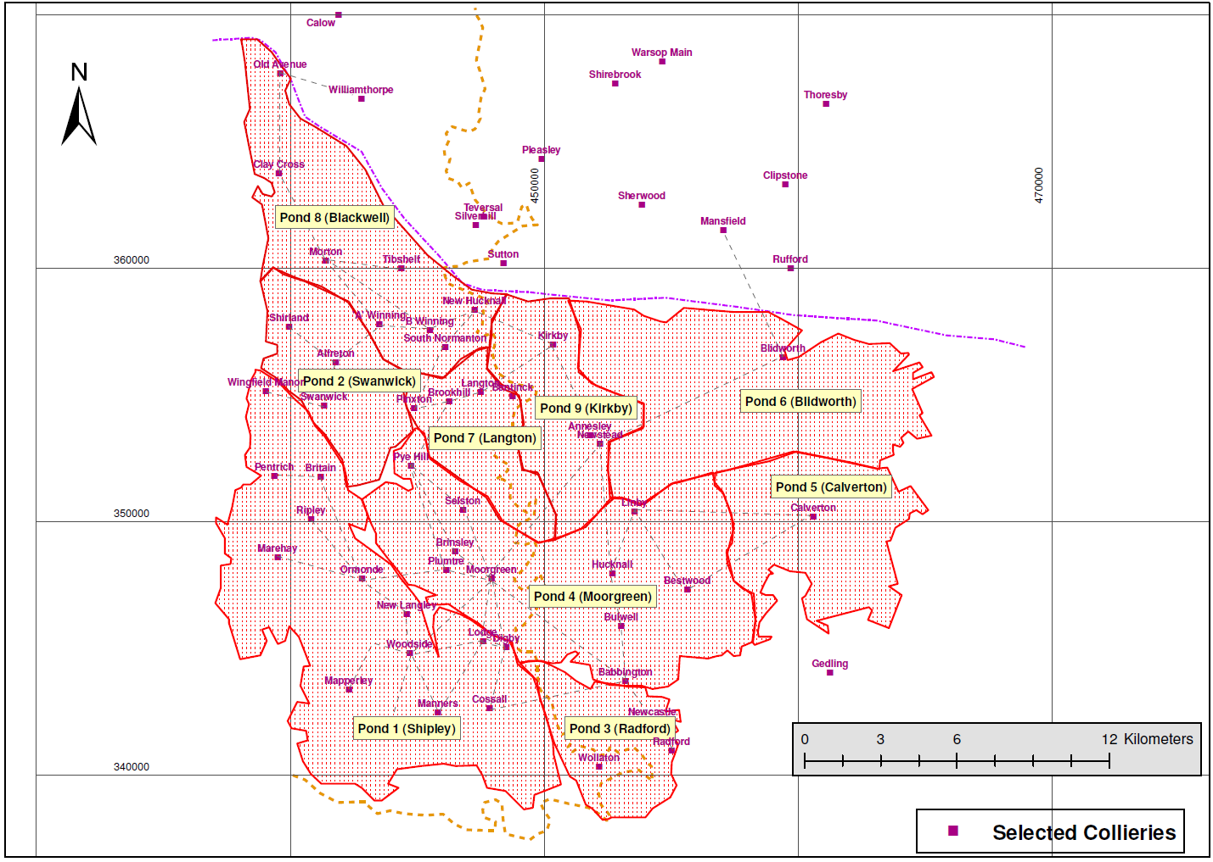
Flow from western outcrop to deep concealed eastern mines
Probable water flow path

Slide 3
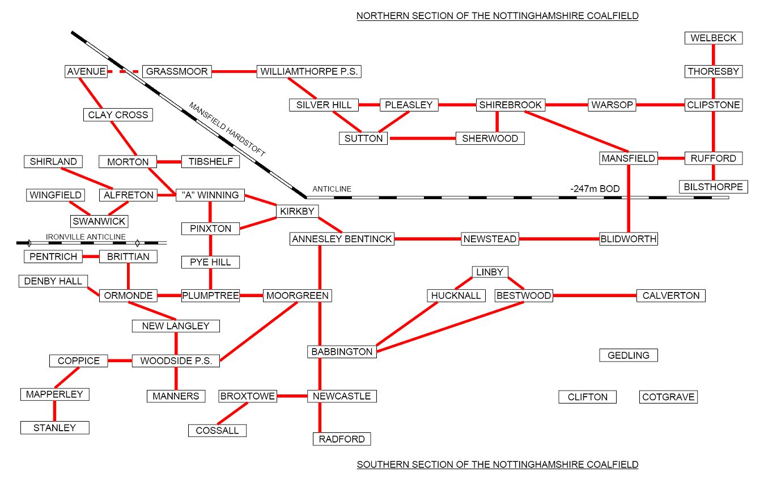
Mine Connections
Isolated Mines

Slide 4
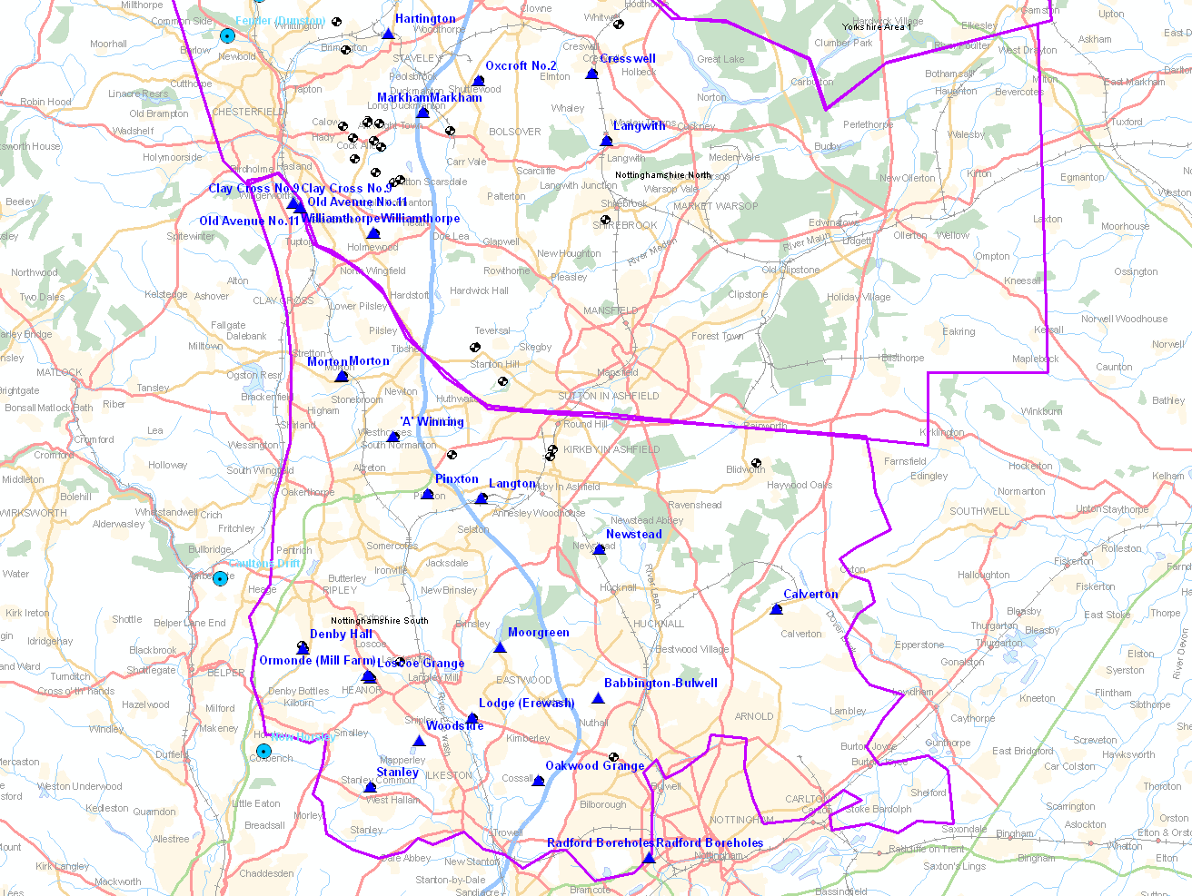
Monitoring Sites -
Water level, Gas, Discharges

Slide 5
Monitoring sites within the South Nottinghamshire Coalfield
Site | County | Purpose | Data from
Kirkby Drift BH | Nottinghamshire | Gas Venting | 1995
A Winning Shaft | Derbyshire | Water Level / Future Pumping | 1996
Avenue Shaft | Derbyshire | Water Level | 1996
Clay Cross Shaft | Derbyshire | Water Level | 1996
Morton Shaft | Derbyshire | Water Level | 1996
Woodside Shaft | Derbyshire | Water Level / Pumping | 1999
Calverton Shaft | Nottinghamshire | Water Level / Gas Extraction | 2000
Langton Shaft | Derbyshire | Water Level / Gas Venting | 2000
Denby Hall BH | Derbyshire | Water Level | 2001
Oakwood Grange BH | Derbyshire | Water Level | 2001
Ormonde BHs | Derbyshire | Water Level / Gas Venting | 2001
Stanley BH | Derbyshire | Water Level | 2001
Radford BHs | Nottinghamshire | Water Level | 2007
Babbington BH | Nottinghamshire | Water Level | 2010
Moorgreen BH | Nottinghamshire | Water Level | 2010
Newstead BH | Nottinghamshire | Water Level / Gas Monitoring | 2010
Lodge BH | Nottinghamshire | Water Level | 2011
Pinxton BH | Derbyshire | Water Level | 2011
Linby BH | Nottinghamshire | Water Level or Gas | 2012

Slide 6
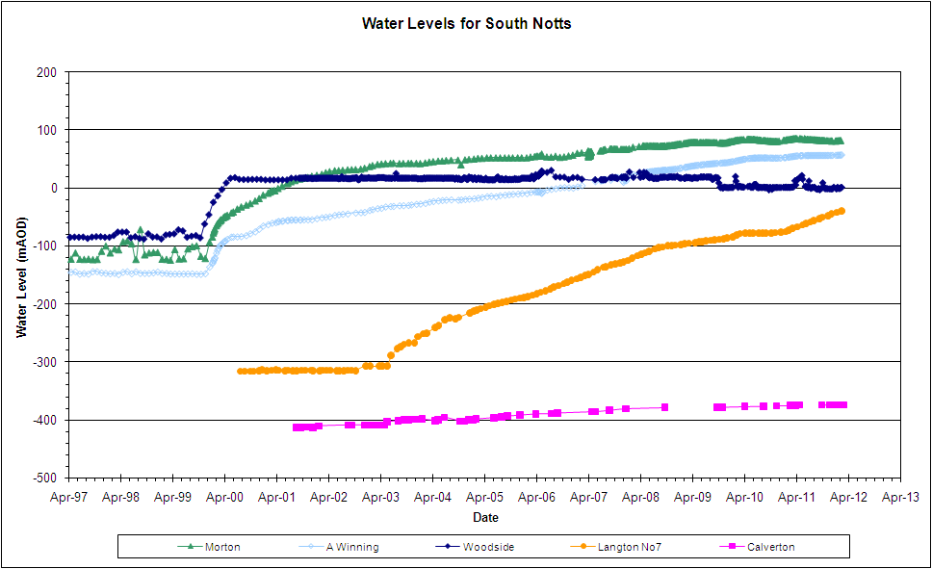
Monitoring Rising Trends – overview all areas

Slide 7
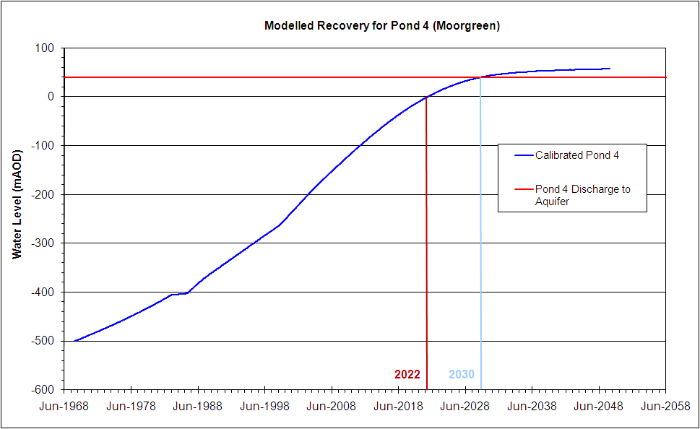
Modelling Results – central area of South Notts coalfield

Slide 8
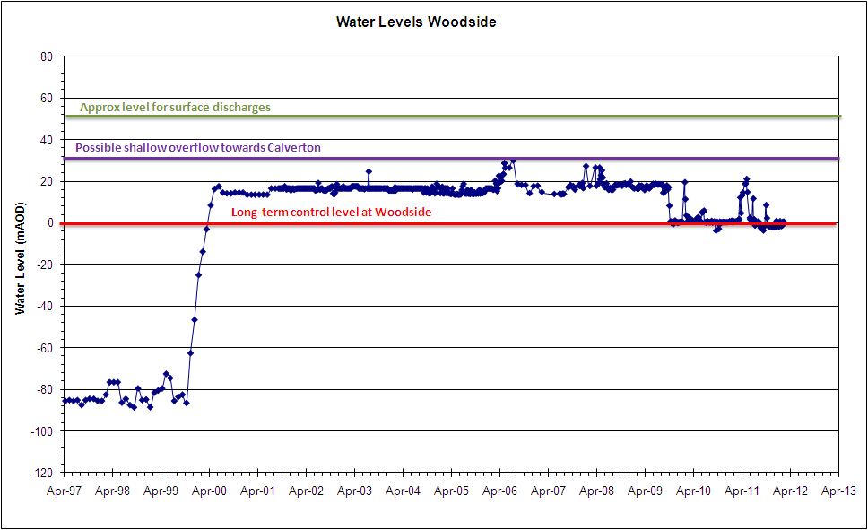
Woodside water level trends, controlled by pumping

Slide 9
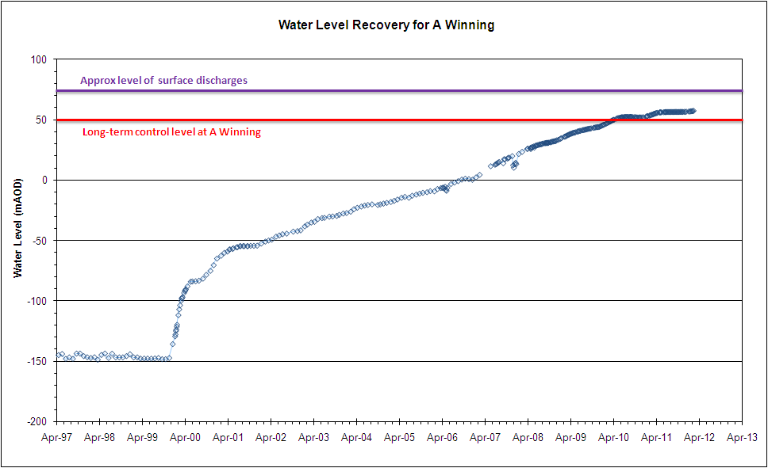
A Winning water level trends, pumping due to start 2012-13

Slide 10
A Winning
PUMP
150l/s
Good Quality
Calverton
PUMP
100-150l/s
Saline Water
Woodside
PUMP
100-150l/s
Good Quality

Slide 11
Strategy
Continue monitoring
Continue pumping at Woodside
Complete scheme at A Winning and start pumping
Evaluate need for more monitoring
Continue dialogue with EA re options
Engage wider stakeholders in discussions

